Slide 1
David S. Ingalls Rink
Amy Huan | Tech 4a Schematic Design Presentation | 12.09.2013

Slide 2
|General Building Data
Building name: David S. Ingalls Rink
Location: New Haven, CT
Building Occupant: Yale University
Architect: Eero Saarinen
Date Constructed: 1953 – 1959 (renovation 2008-2010)
Building Footprint: 47,983 sf
Total gsf: 61,646 sf
Total Levels: 2
|Project Team
Architect: Kevin Roche John Dinkeloo and Associates, LLC
Lighting Consultant: Atelier Ten Consulting Designers

Slide 3
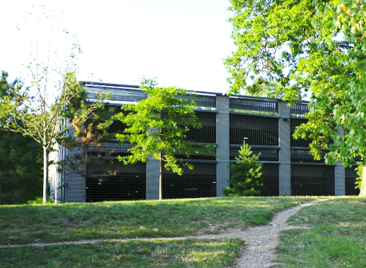
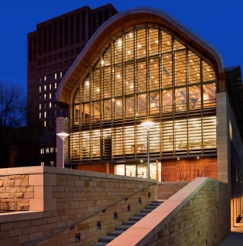
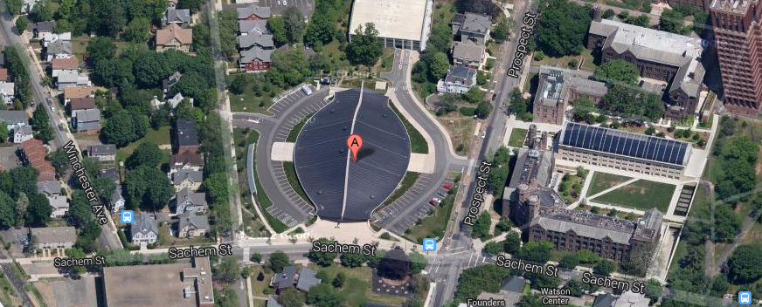
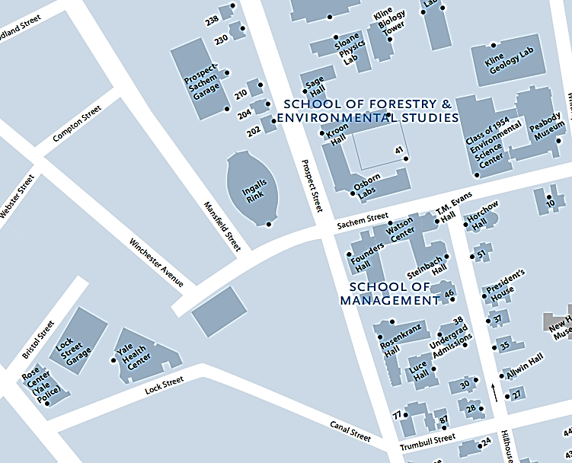
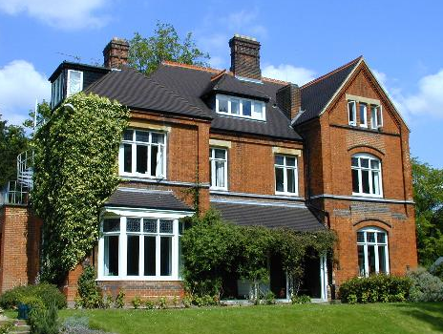
School of Forestry & Environmental Studies
|Building Location
N
Prospect Sachem Garage
Student Housing
under construction
Residential Houses
Notes:
Yale North Campus

Slide 4
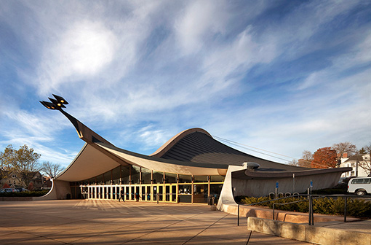
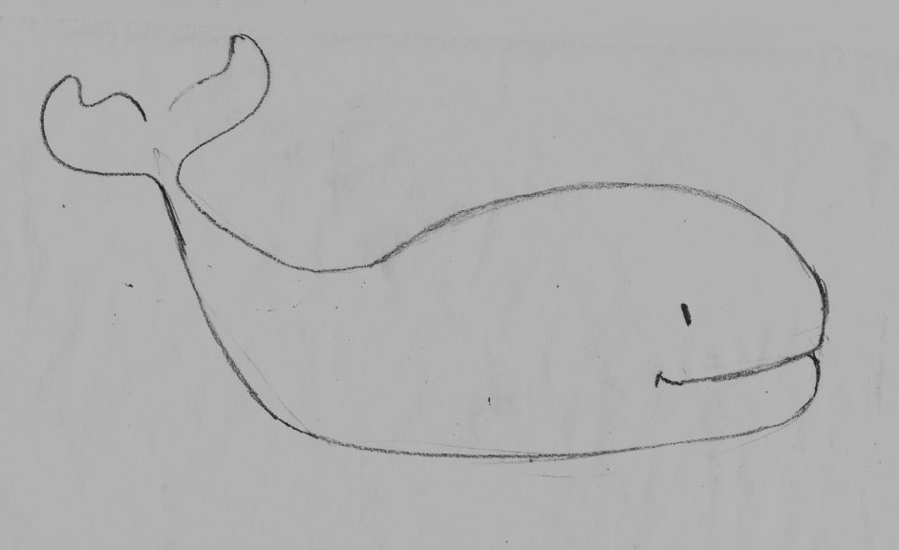
Habitation
The Yale “Whale”

Slide 5
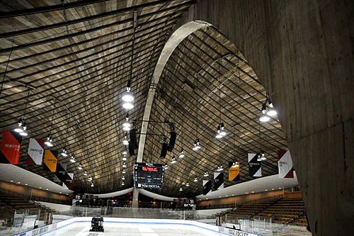
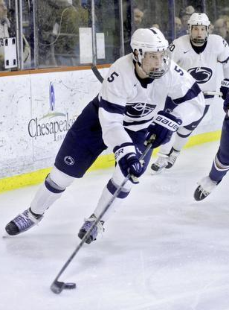
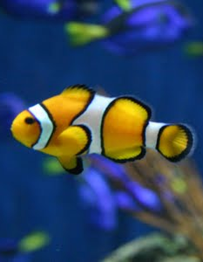
Habitation

Slide 6
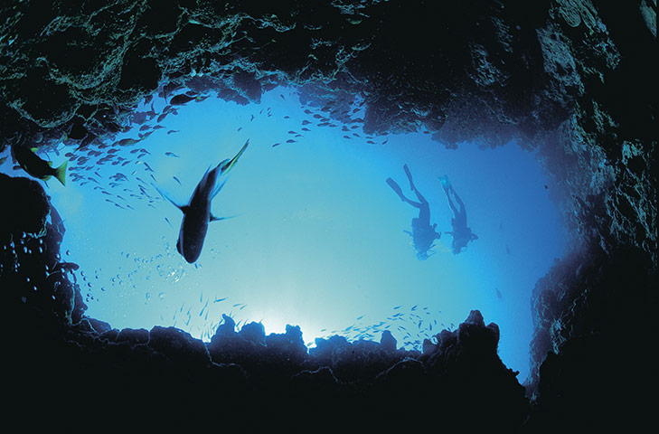
Habitation

Slide 7
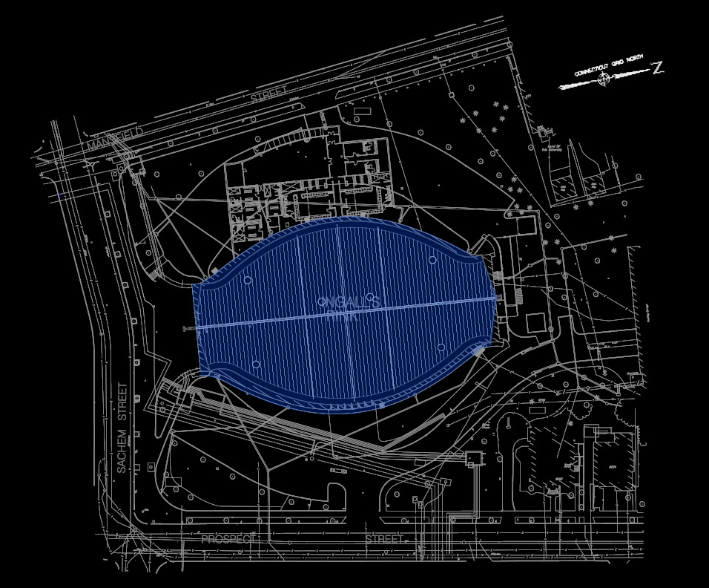
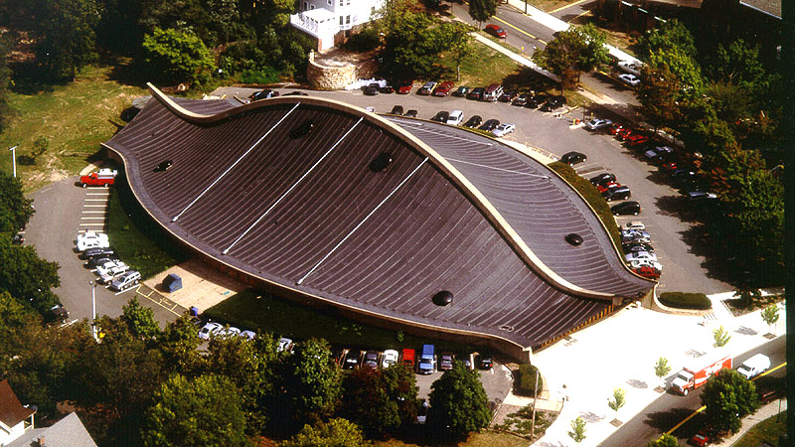
|BUILDING EXTERIOR
| Design Criteria
Enhance architecture + environment
Respect history
Establish nighttime identity
Minimize glare, sky glow and light trespass
3 schematic design solution
Lms/sf = 2.5; lms/site = 7000 (LZ2)
Ev_{max} = 3 lx @property line (LZ2)
Notes:
Building Exterior
Recognized as the “best design” across all of America by NY Times
Venerable history and reputation as a hollowed spot
Function / structure / being part of the time
Relation to neighborhood
Mass and scale
Dramatic structural elements
Enhance the surrounding environment
Respect the historically significant architecure
Integrate with existing landscape such as tree and street poles

Slide 8
Jump
Dive
Swim

Slide 9
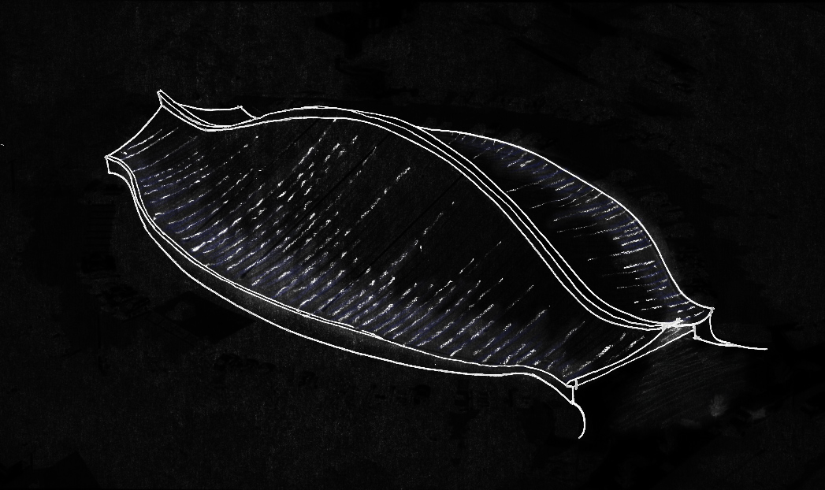
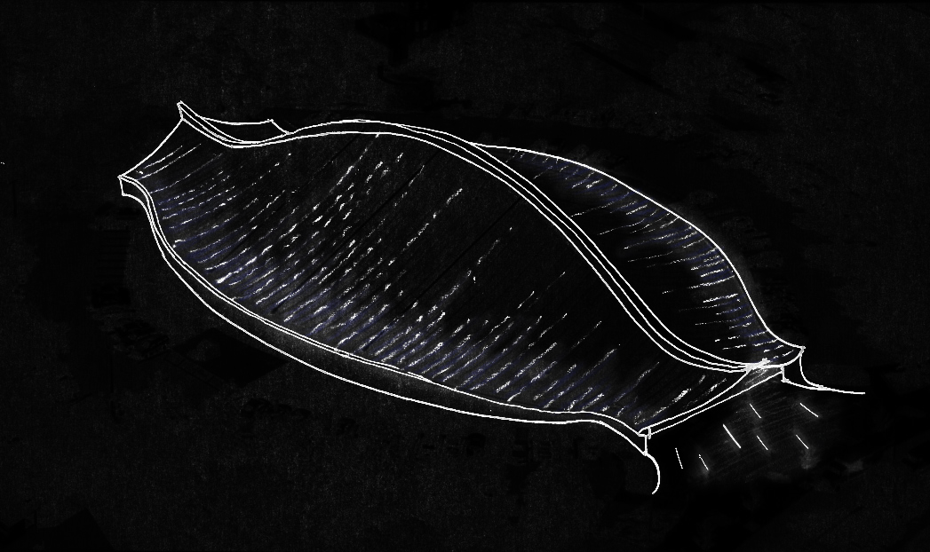
|BUILDING EXTERIOR
|Schematic 1: Jump
motion + splash
- LED node with programmed sequence
- in-ground uplights
- linear grazer for exterior walls
- Existing lighting sculpture with “dragon eye”

Slide 10
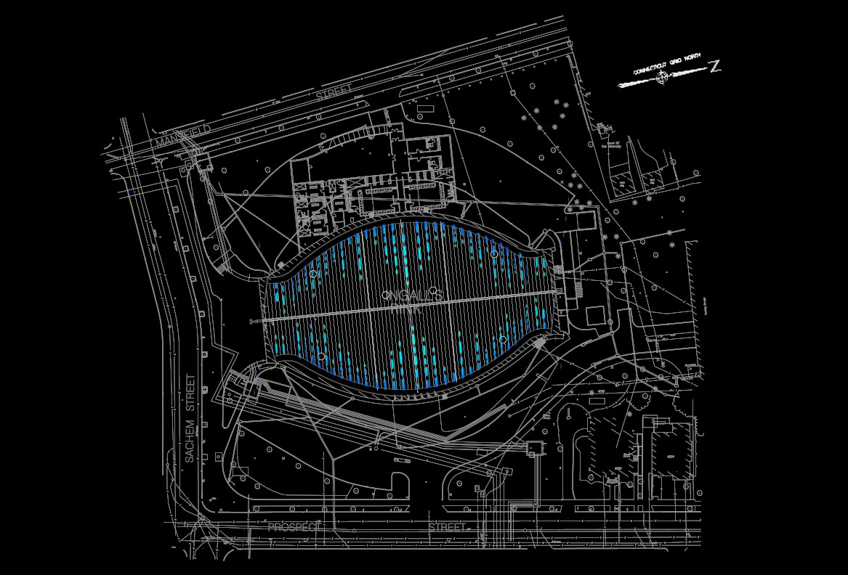
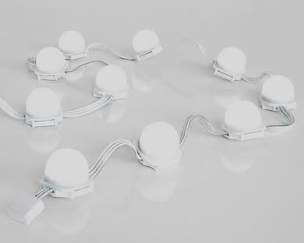
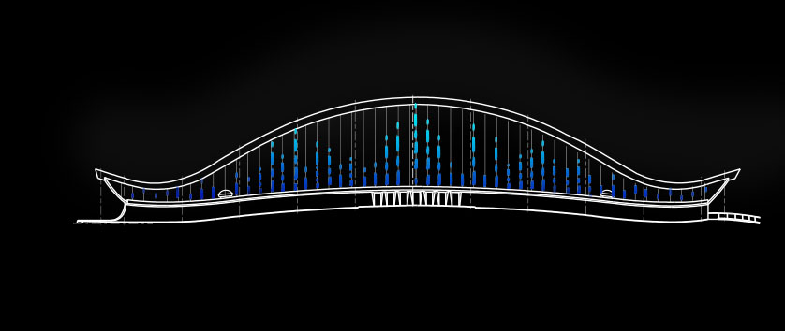
|BUILDING EXTERIOR

Slide 11
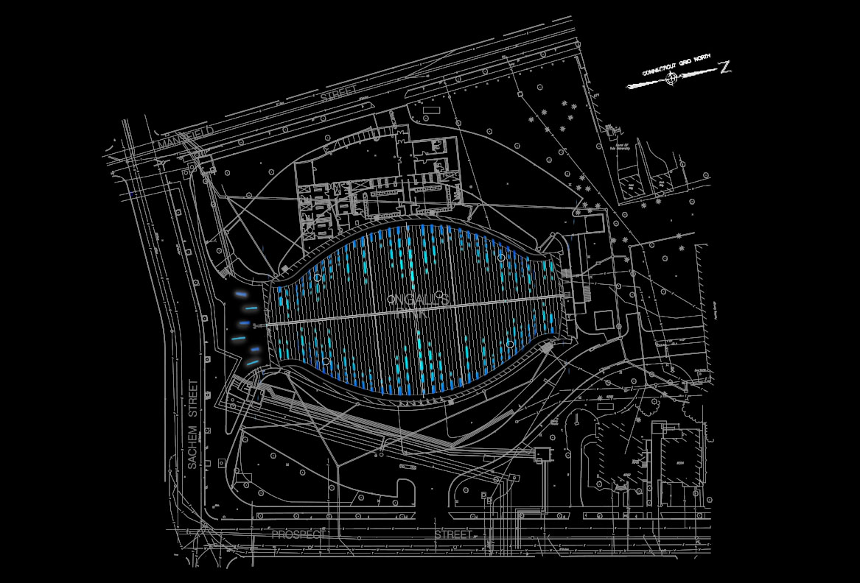
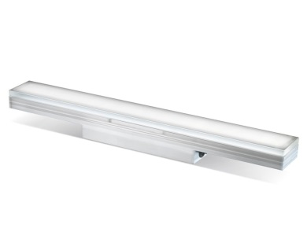
|BUILDING EXTERIOR

Slide 12
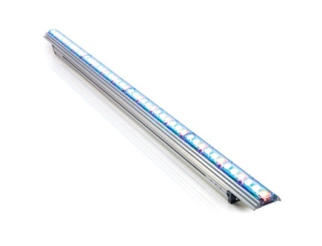
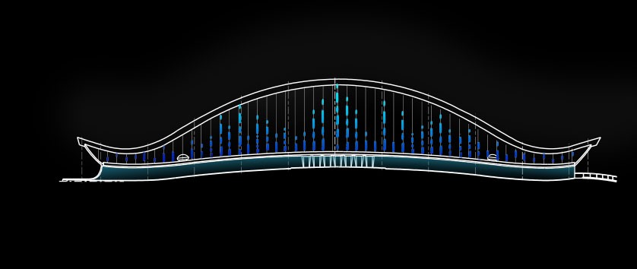
|BUILDING EXTERIOR

Slide 13
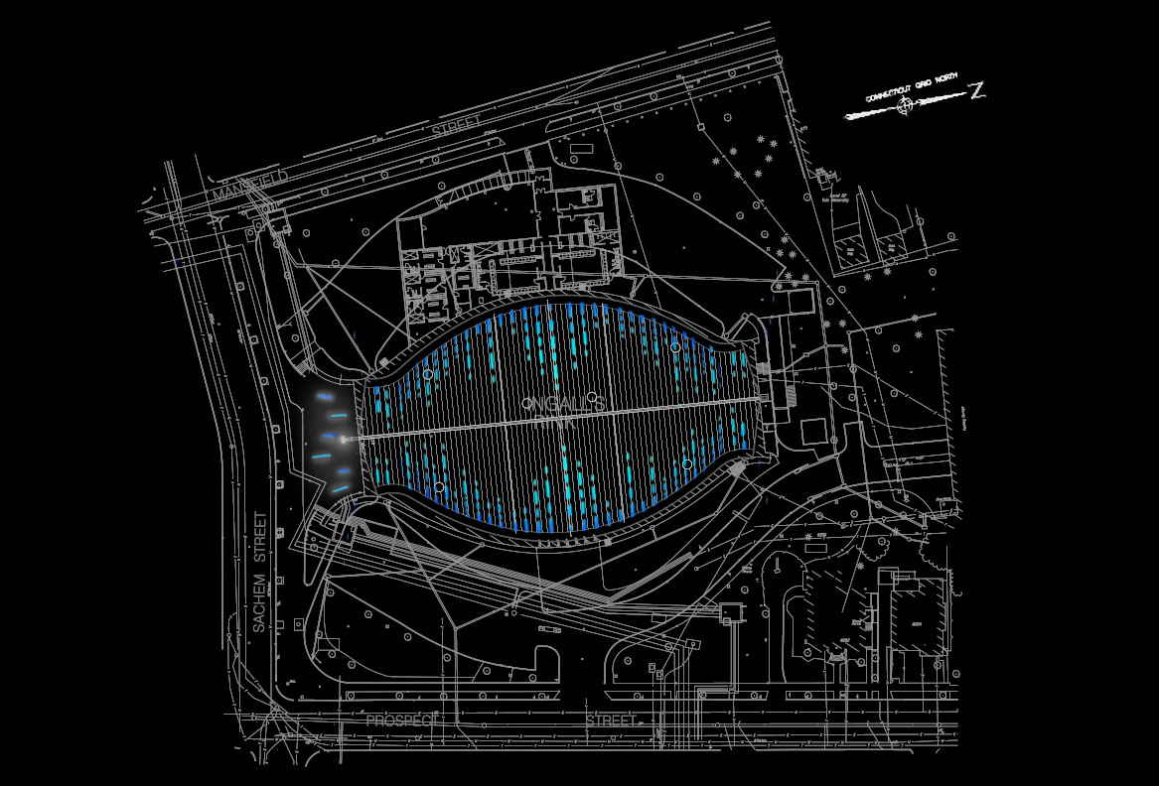
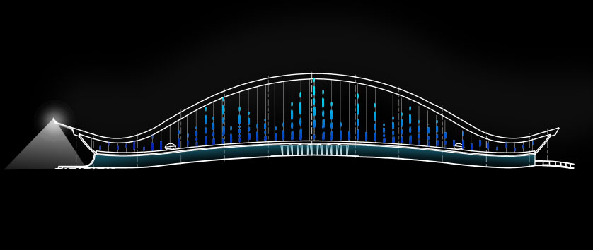
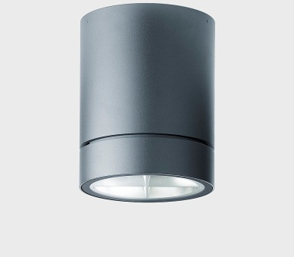
|BUILDING EXTERIOR

Slide 14
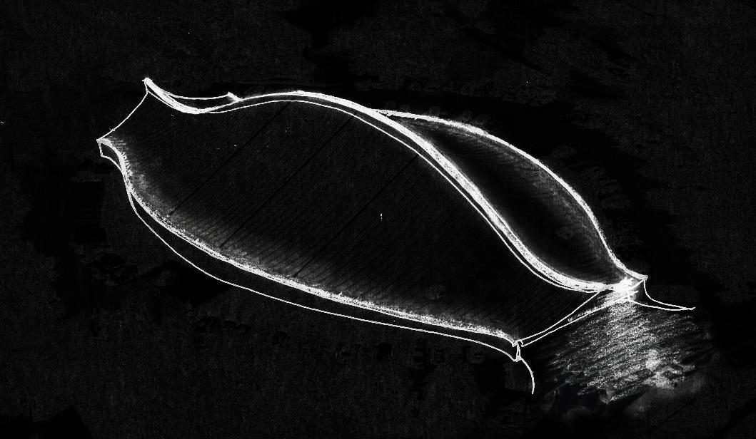
|BUILDING EXTERIOR
|Schematic 2: Dive
curve + tail fins
- Linear uplight on the spine
- Linear grazer on roof edge
- Existing lighting sculpture with “dragon eye”
(@higher level)

Slide 15
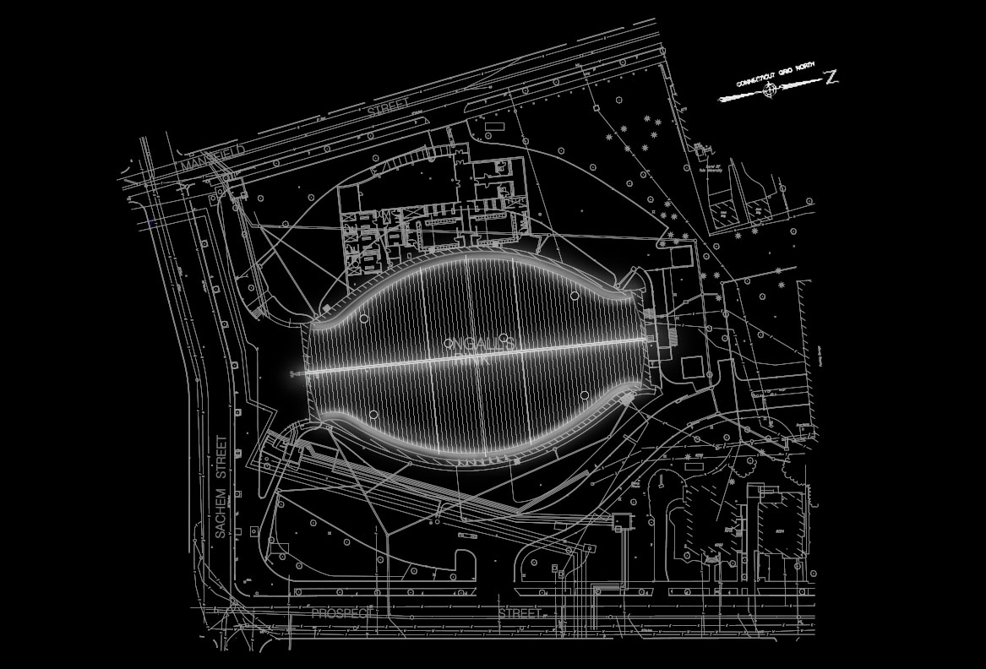
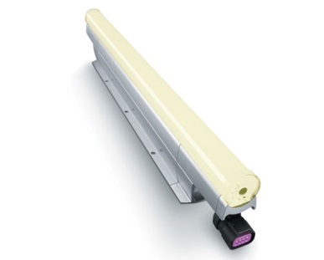
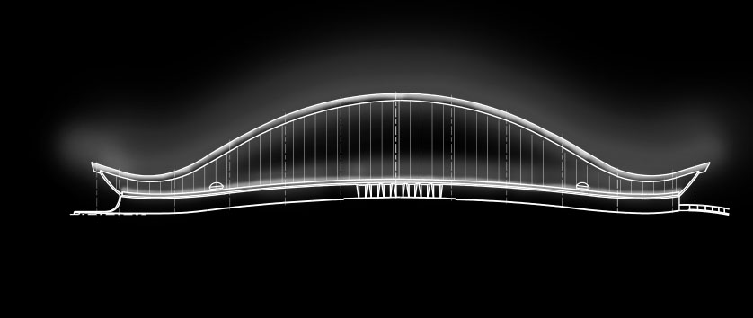
|BUILDING EXTERIOR

Slide 16
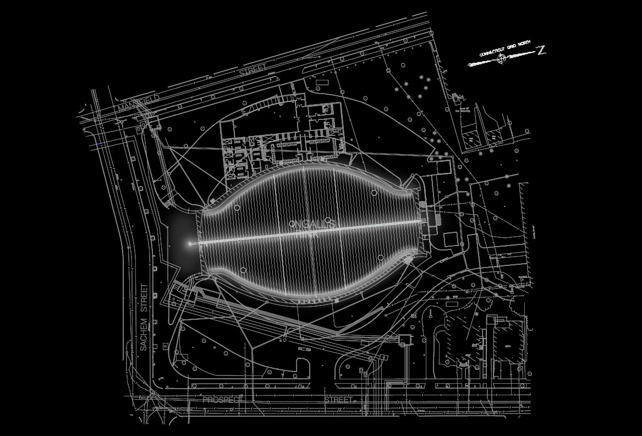
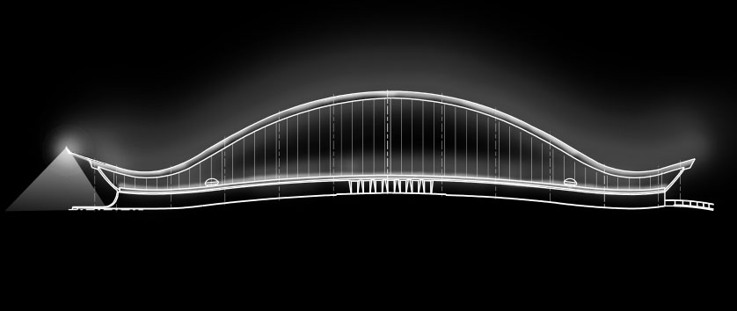
|BUILDING EXTERIOR

Slide 17
|BUILDING EXTERIOR
|Schematic 3: Swim
highlight + shimmer
- Linear grazer from mid-spine
- in-ground uplights
- Linear grazer for exterior walls
- Existing lighting sculpture with “dragon eye”
Notes:
Linear grazer for exterior walls: floating effect

Slide 18
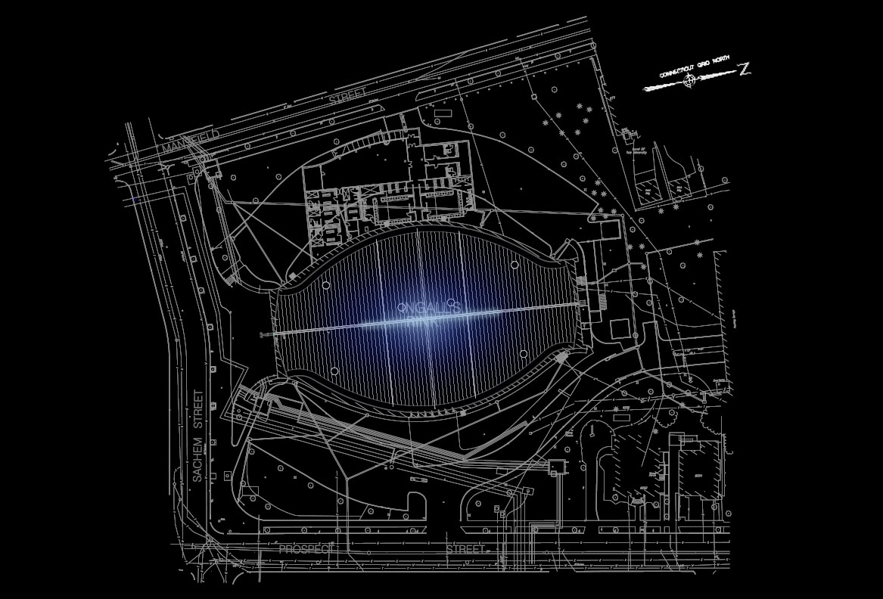
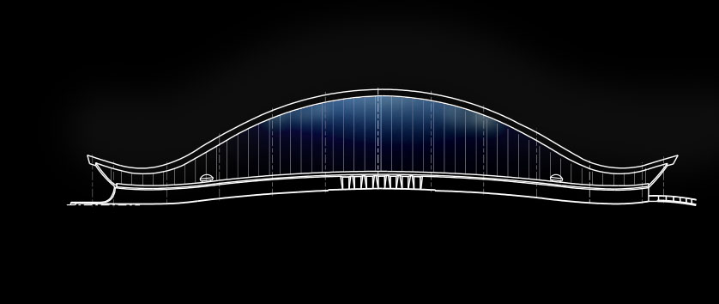
|BUILDING EXTERIOR

Slide 19
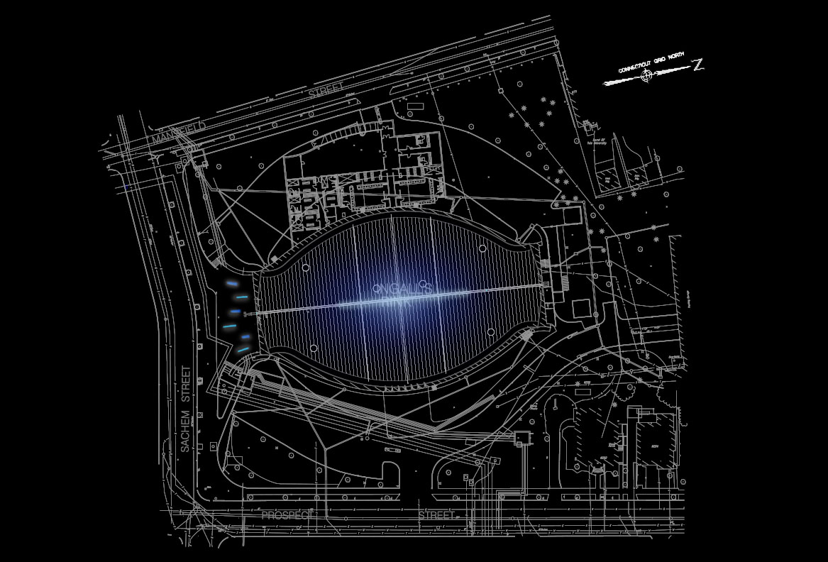
|BUILDING EXTERIOR

Slide 20
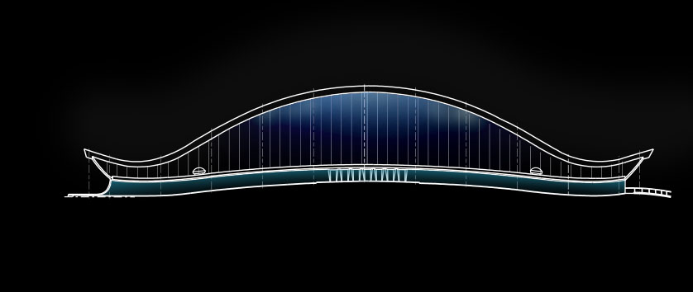
|BUILDING EXTERIOR

Slide 21
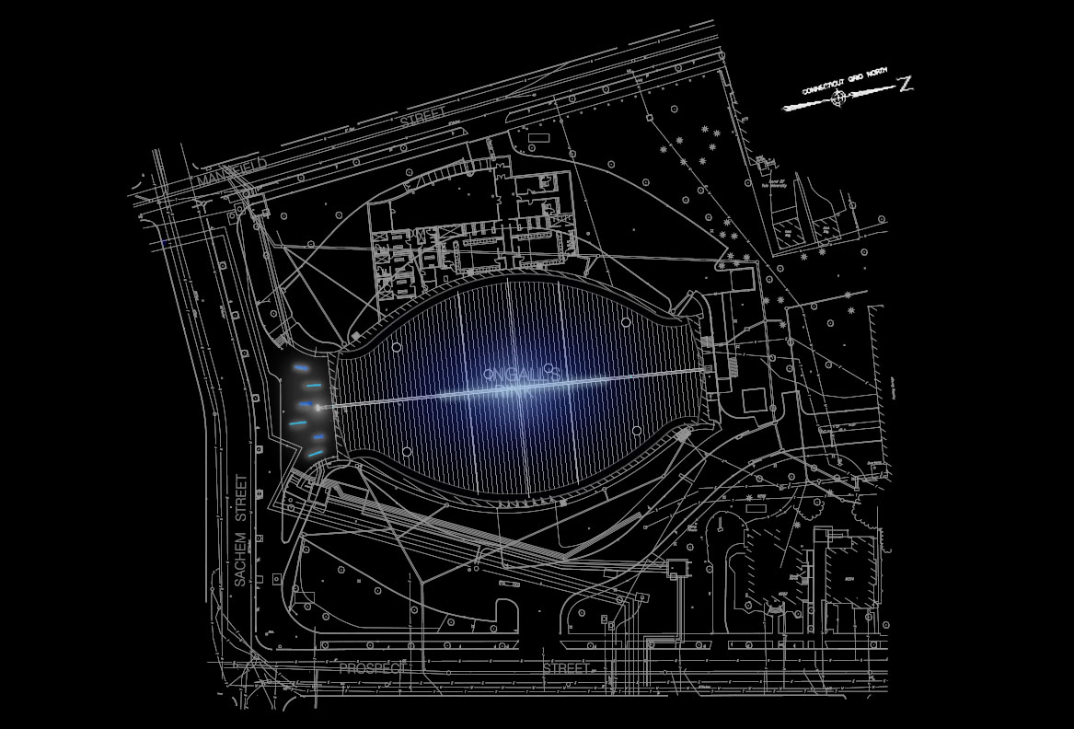
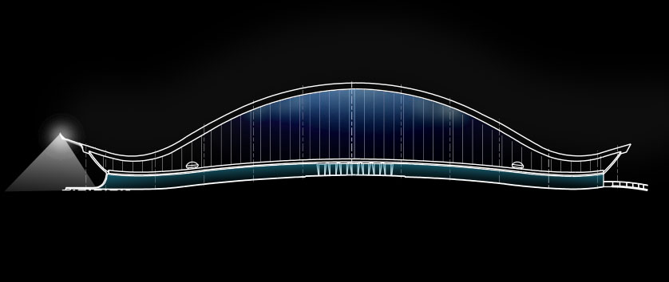
|BUILDING EXTERIOR

Slide 22
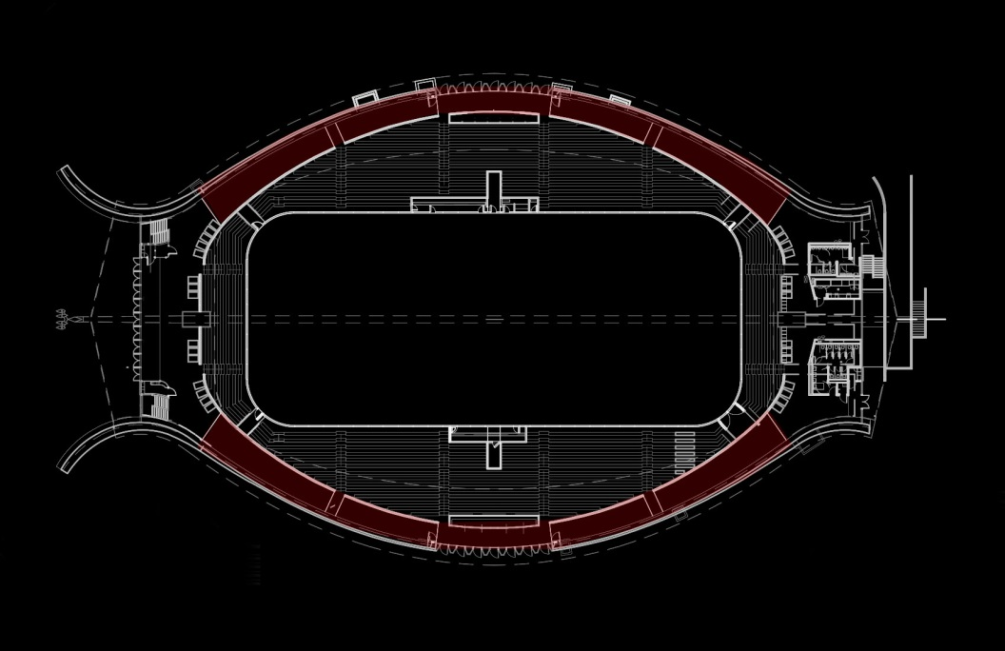
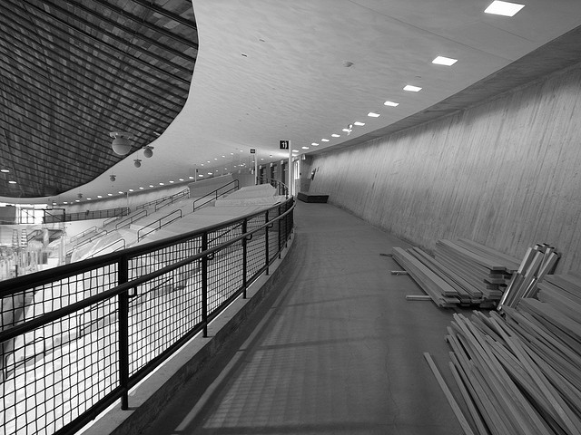
|CIRCULATION
| Design Criteria
Lead direction
Decrease distraction
Reduce glare at pressbox area
Accent wall texture
Avg ≥ 0.2 times task E_{h} of adjacent space; Min ≥ 10lx

Slide 23
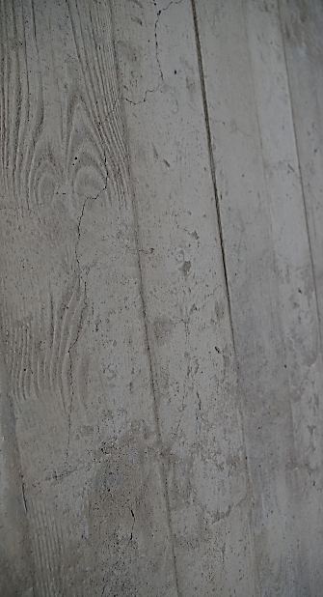
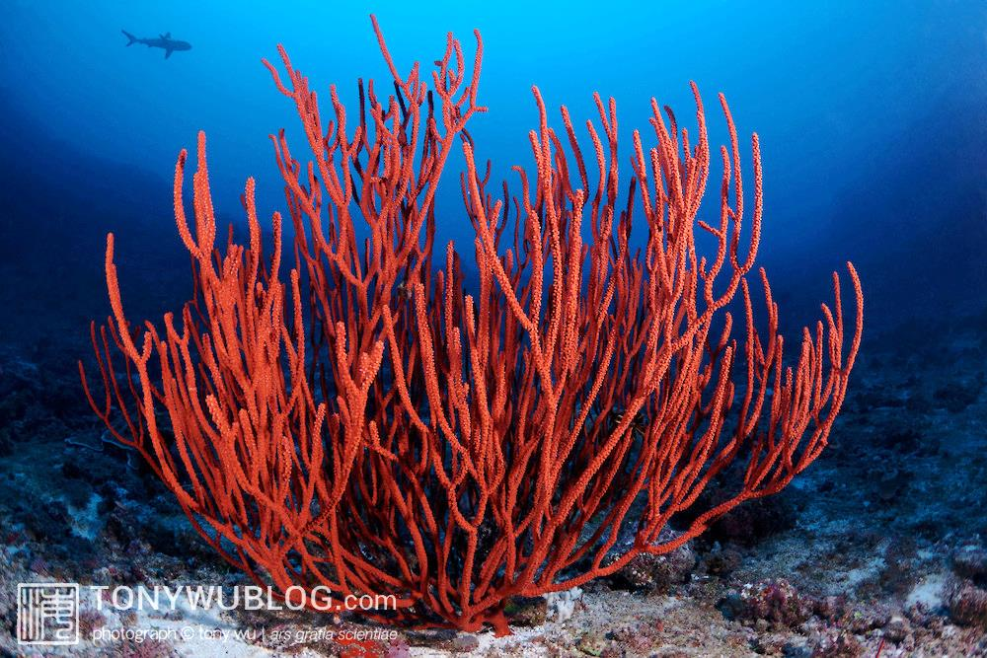
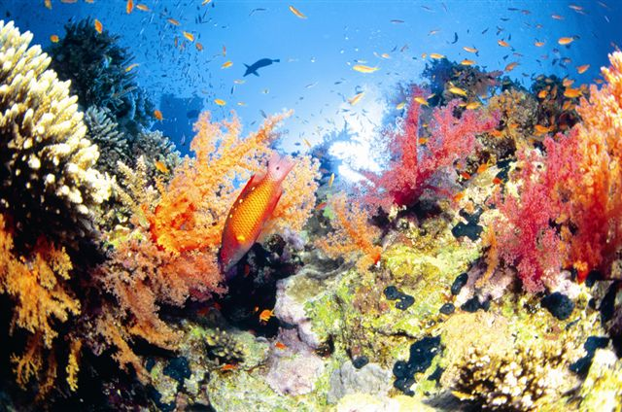
|CIRCULATION
Coral Reef

Slide 24
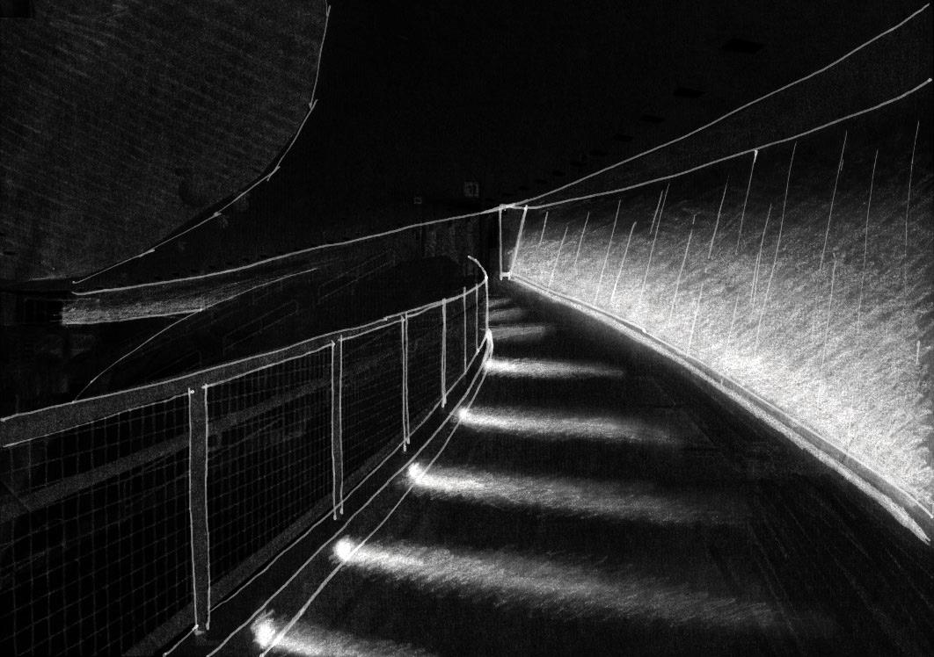
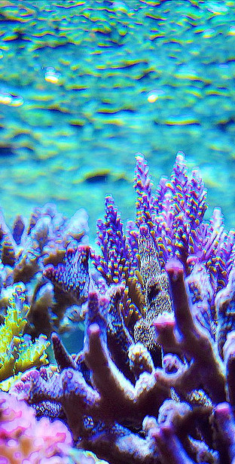
|CIRCULATION
|Coral Reef
verticalness
- Step lights to lead directions
- Linear uplight to graze the wall texture
- Recessed downlights for pressbox task illumination
Notes:
Linear grazer for exterior walls: floating effect

Slide 25
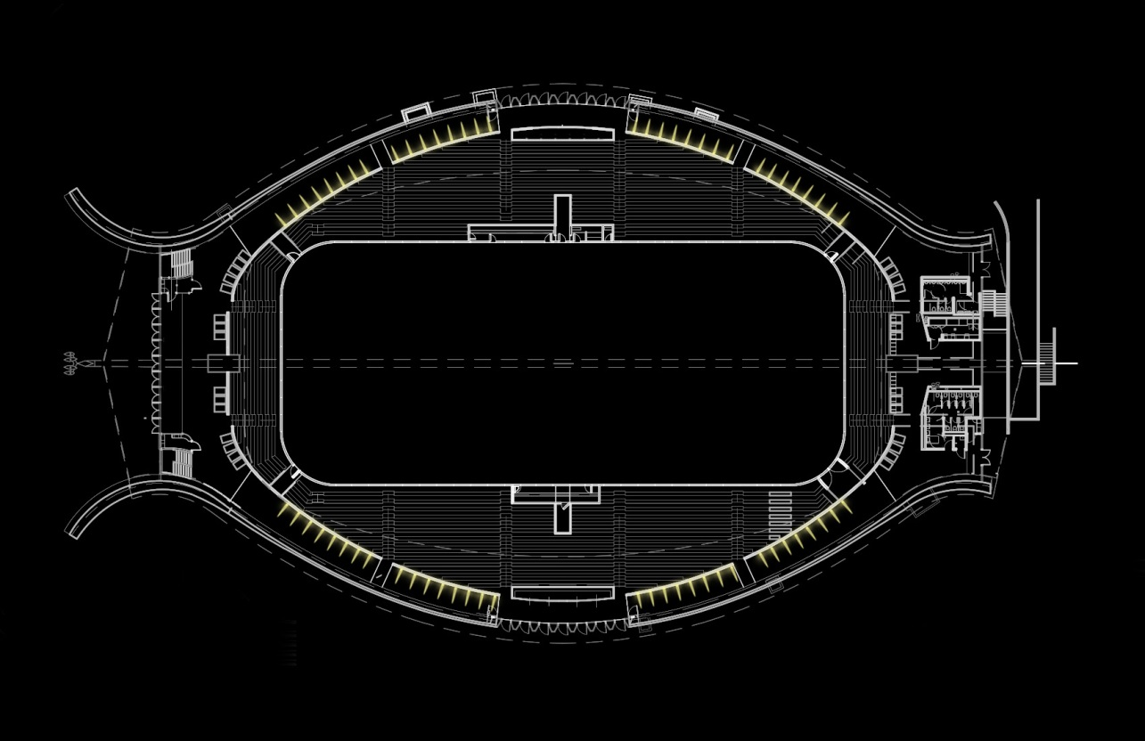
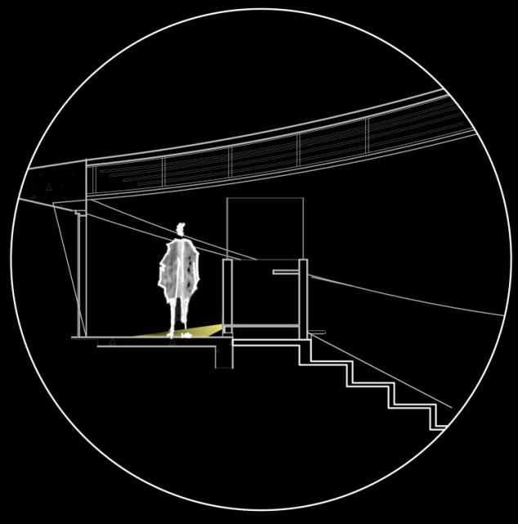
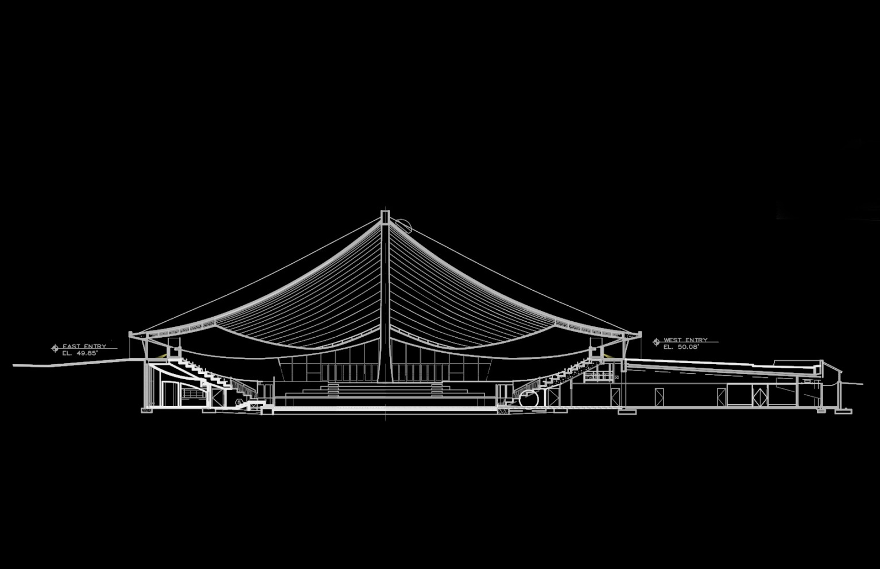
|CIRCULATION

Slide 26
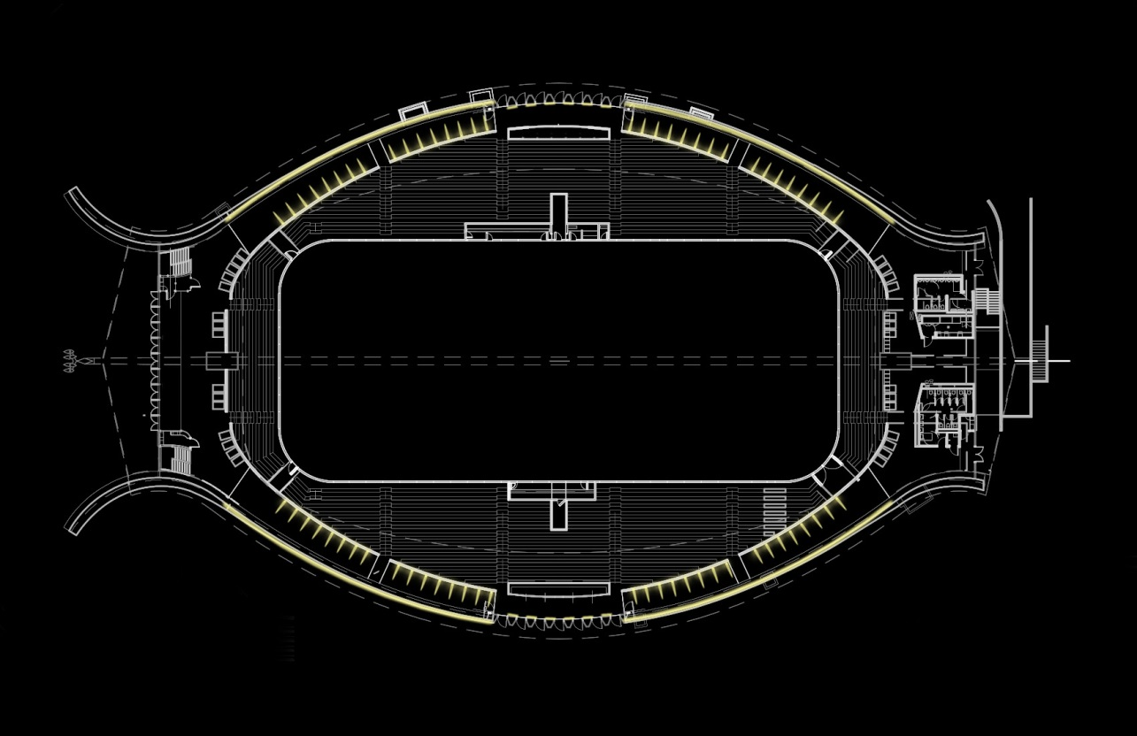
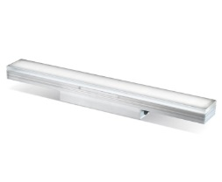
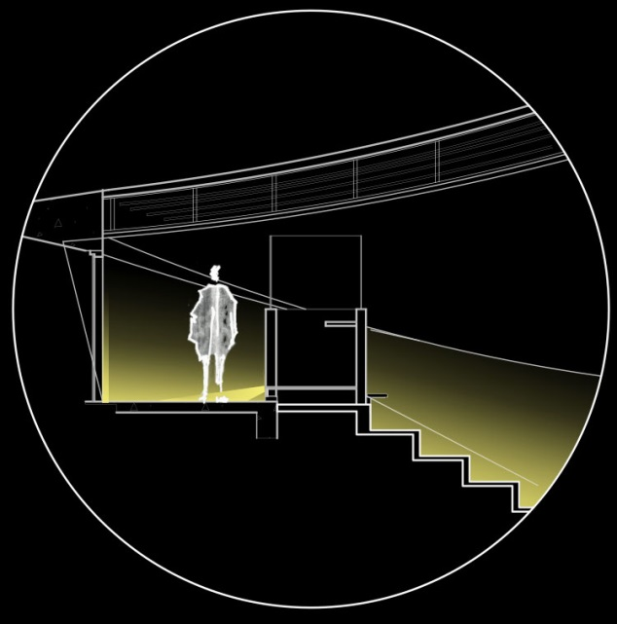
|CIRCULATION

Slide 27
|CIRCULATION

Slide 28
|RINK
| Design Criteria
Promote cheerfulness
Avoid glare
Enhance spatial appearance
Uniformity for sports function
Expressive for figure skating/recreational function
Efficiency + Sustainability
Sports: E_{h} = 1000 lx; E_{v} = 300 lx; Max:Min = 2.5:1
Recreation: E_{h} = 30 lx; E_{v} = 8 lx ; Max:Min = 5:1

Slide 29
|RINK
Ocean

Slide 30
|RINK
|Ocean: Sports
pattern + uniformity
- Linear grazer to accentuate the ceiling
- Use of shadow to expand the dimension
- Pendant downlights to provide uniform distribution
on the ice

Slide 31
|RINK

Slide 32
|RINK

Slide 33
|RINK

Slide 34
|RINK

Slide 35
|RINK
|Ocean: Performance/Recreational
pattern + romance
- Linear grazer to accentuate the ceiling
- Use of shadow to expand the dimension
- Spotlights to focus
- Gobo

Slide 36
|RINK

Slide 37
|RINK

Slide 38
|SCHLEY CLUBROOM
| Design Criteria
Provide adequate light level and desirable highlights for art display
Create a comforting atmosphere
Enlarge the space
Private psychological impression

Slide 39
|SCHLEY CLUBROOM
Deep Ocean Floor

Slide 40
|SCHLEY CLUBROOM
|Schley Clubroom: Deep Ocean Floor
quiet + peaceful
- Recessed spotlights to highlight artworks
- Linear washer for wood panels
- Perimeter lighting on floor level
- Recessed downlights

Slide 41
|SCHLEY CLUBROOM

Slide 42
|SCHLEY CLUBROOM

Slide 43
|SCHLEY CLUBROOM

Slide 44
|SCHLEY CLUBROOM

Slide 46
Thank you.
Professionals
Dr. Houser
Dr. Mistrick
Shawn Good
Penn State AE Department
Atelier Ten

